Slide 1
SPCN 2020 Hackathon
Case №7
Searching and recognizing house numbers
Saint-Petersburg Electrotechnical University ETU “LETI”
Team “FRT”
Members: Kozlova Polina, Gotsko Ivan, Volyntseva Daria, Astafiev Ivan , Bashkova Xeniya (capt.)

Slide 2

Case:
It is necessary to develop a neural network that can find the house number in the images from the provided dataset, that determines its position on the image and recognize it. Also it is necessary to provide case’s results as a presentation and code solution.

Slide 3
Data features
The data from the presented dataset is the addresses of the houses. They have next features:
1. Consist only of numbers
2. It can contain from 1 to 9 digits, and it is not known in advance how many
3. Background and number can be of any color, can be written in any font
4. Perspective distortions occur
5. There are two datasets: full numbers and cropped numbers
All this complicates the task of recognizing numbers

Slide 4

Method
The Python programming language was chosen as the implementation tool, as the participants are familiar with it. In addition, this language has extensive capabilities for working with neural networks.
The type of MLP (Multilayered perception) neural network is selected. This is a fairly easy-to-understand and not resource-demanding model. In addition, there are many materials and guides on this topic.
The work used tensorflow library.

Slide 5
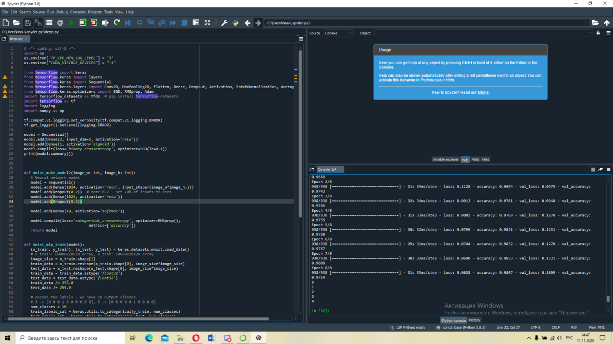
Interim results
To solve the problem, the following code was written, which can be found in more detail here https://github.com/FRT2020/net. Here you can see the learning process of the neural network:

Slide 6
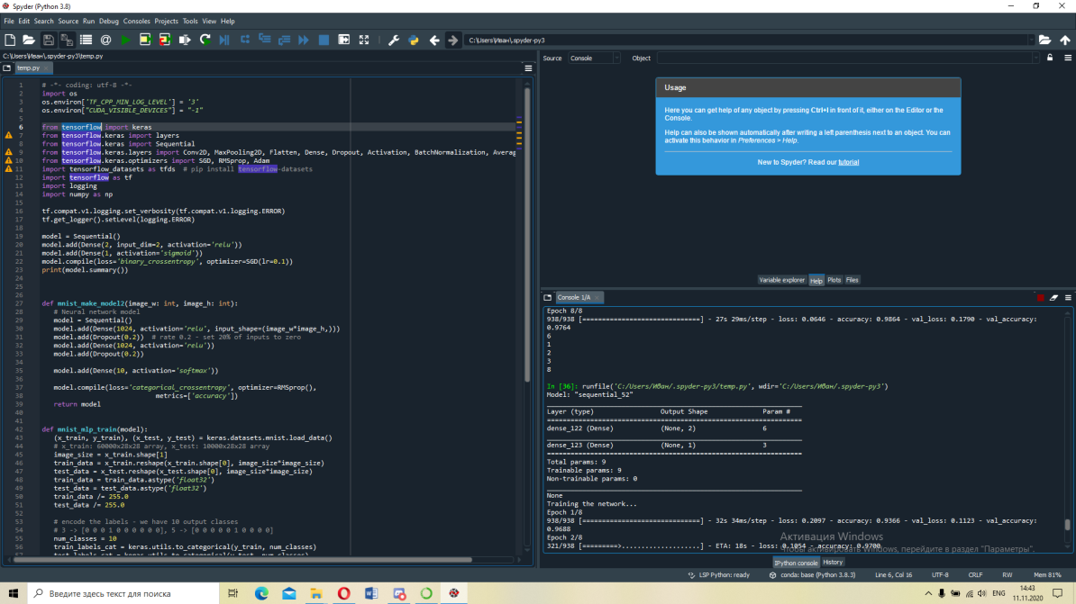
Interim results
Here you can see the learning process of the neural network:

Slide 7
Results
We made a solution for neurals (written with Python language), our neural network can recognize numerals from 1 to 9. It can also recognise pictures of numbers of all sizes. It has some problems with angle of “spelling” numerals. and that’s it. Our neural network works fast, without any interruptions and glitches, failures.
Our solution had been submitted to it in accordance with the rules.

